Slide 1

Cyclistic Bike-Share Analysis: Converting Casual Riders to Subscribers A Data-Driven Strategy for Increasing Membership
Name: Pushya Shree Konasale Jayaramu Email: pushyashree.kj.2000@gmail.com

Slide 2
Problem Statement
Cyclistic wants to increase its annual subscribers. Understanding ridership behavior will help us create a strategy to convert casual riders into members.
Key Questions:
How do casual riders and subscribers differ in their usage patterns?
What marketing strategies will effectively convert casual riders into annual members?

Slide 3

Data and Methodology
Data Source: Cyclistic bike-share dataset
Tools Used: SQL (BigQuery) + Python
Key Metrics Analyzed:
Ridership trends (monthly, weekly, hourly)
Demographic insights (age, gender)
Ride duration by user type

Slide 4

Monthly Bike Usage Patterns

Slide 5
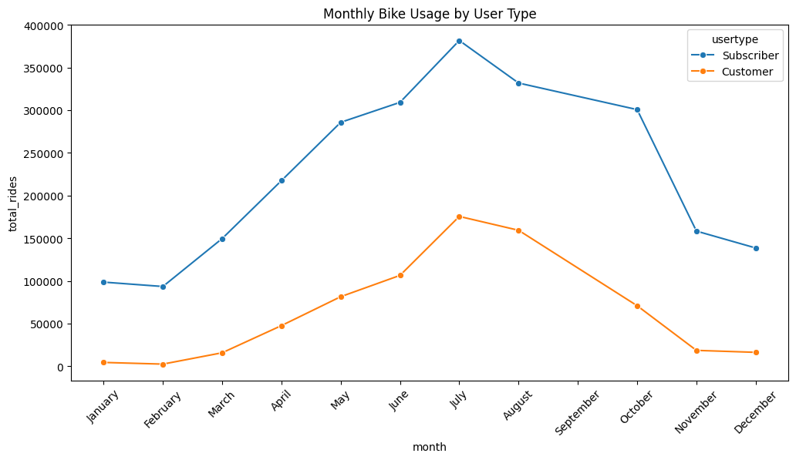
Monthly Bike Usage Patterns
Key Findings:
Subscribers ride consistently year-round, while casual riders peak in summer.
Subscribers → High engagement year-round
Casual Riders → Seasonal peaks (June–August)

Slide 6
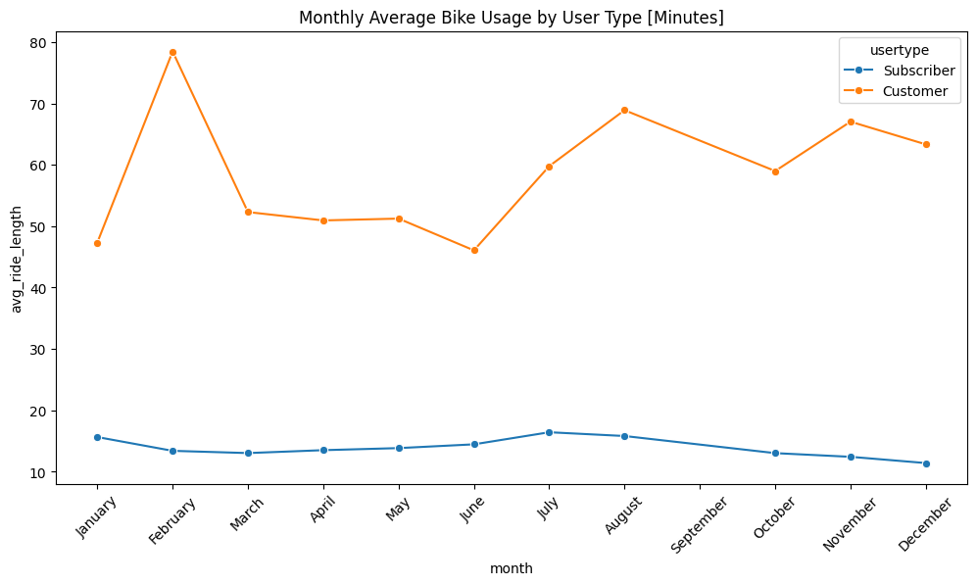
Monthly Bike Usage Patterns
Key Findings:
Casual riders (Customers) have much longer rides than Subscribers across all months.
Casual riders are more likely to use bikes for leisure, while subscribers use them for commuting.
Longer summer ride times suggest tourists or recreational riders.

Slide 7

Monthly Bike Usage Patterns
Business Implication:
Target casual riders with promotional summer membership offers.
Focus marketing efforts on retention strategies for casual summer users.

Slide 8
Weekly Bike Usage Patterns

Slide 9
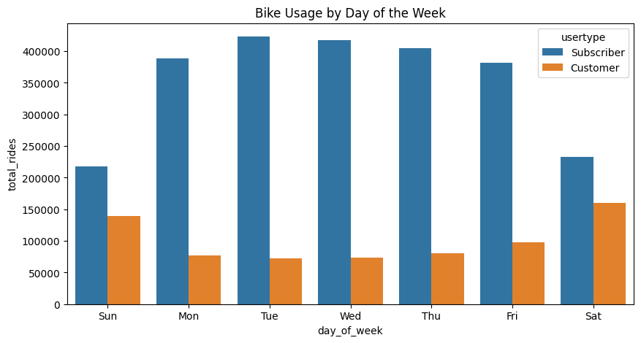
Weekly & Daily Ride Behavior
Key Findings:
Subscribers ride more on weekdays, while casual riders prefer weekends.
Subscribers → Peak on weekdays (commuting patterns)
Casual Riders → Higher usage on weekends (leisure trips)

Slide 10
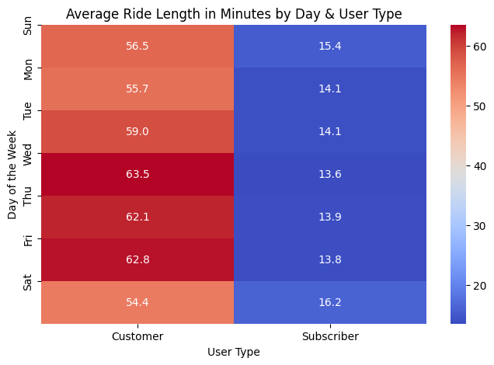
Weekly & Daily Ride Behavior
Key Findings:
Subscribers have consistent ride lengths (~14-16 min) across all days.
Casual riders use bikes for extended trips, likely for leisure rather than commuting.
Thursday & Friday peaks suggest casual riders use bikes for evening outings.

Slide 11
Weekly Bike Usage Patterns
Business Implication:
Weekend Subscription Offers → Introduce an “Unlimited Weekend Pass” as a steppingstone to full membership.
Social Riding Incentives → Offer referral discounts when casual users ride with friends.

Slide 12
Hourly Bike Usage Patterns

Slide 13
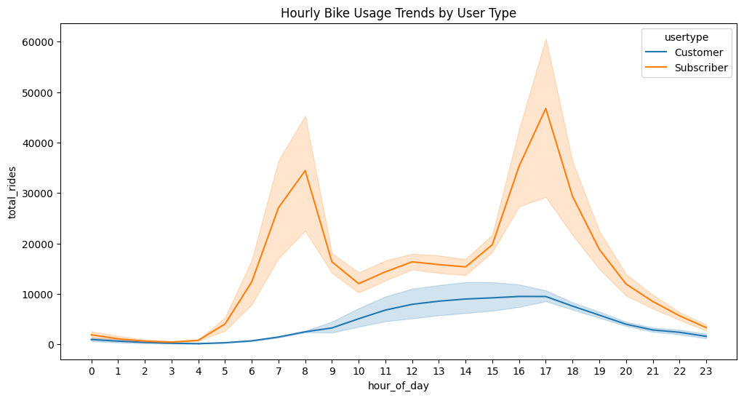
Hourly Ride Behavior
Key Findings:
Casual riders have very high ride lengths at night (~100-170 minutes between 12 a.m. – 4 a.m.).
Ride length gradually decreases for casual riders after 5 a.m. and stabilizes from morning to evening.

Slide 14
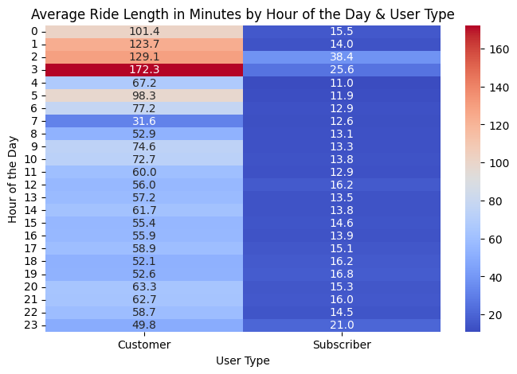
Hourly Ride Behavior
Key Findings:
Late-night rides (12 a.m. – 4 a.m.) are unusually long for casual riders, possibly tourists or partygoers.
Subscribers consistently use bikes for short trips, confirming their commuter behavior.

Slide 15
Hourly Bike Usage Patterns
Business Implication:
Night Owl Memberships → Introduce discounted late-night passes for casual users.
Tourist-Friendly Offers → Provide hourly rental caps to push tourists toward short-term memberships.

Slide 16
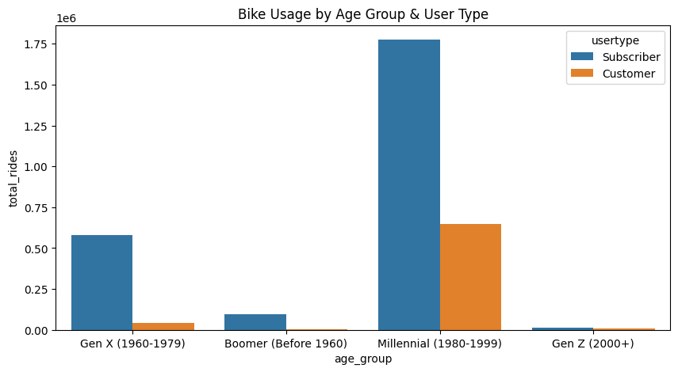
Demographic Insights
Millennials & Gen X dominate ridership. Males ride more than females.
Largest user base: Millennials (1980-1999)
Gen Z & Boomers have lower engagement.
Male riders significantly outnumber female riders.

Slide 17
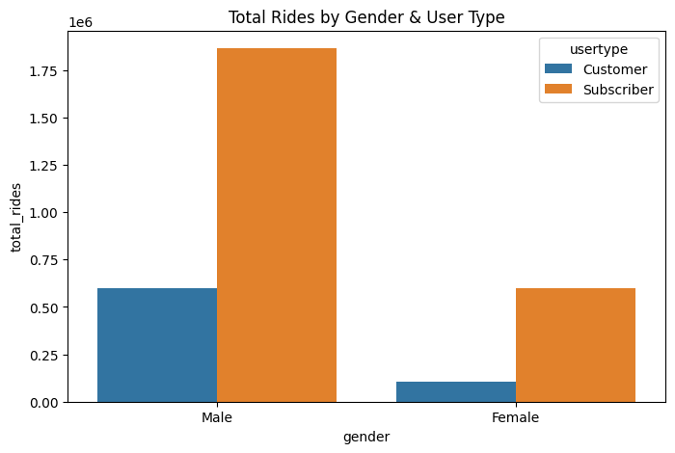
Demographic Insights
Millennials & Gen X dominate ridership. Males ride more than females.
Largest user base: Millennials (1980-1999)
Gen Z & Boomers have lower engagement.
Male riders significantly outnumber female riders.

Slide 18
Demographic Insights
Business Implication:
Target Millennials & Gen Z with flexible membership plans.
Address gender disparity by improving bike safety and accessibility for women.

Slide 19

Key Business Recommendations
💡 Seasonal Membership Offers
Target casual riders with discount membership trials before peak summer.
💡 Work Commute Incentives
Promote annual membership for daily commuters with morning/evening ride perks.
💡 Weekend Promotions
Offer unlimited weekend rides for casual users as an entry-level subscription plan.

Slide 20
Key Business Recommendations
💡 Targeted Ads & Campaigns
Run Millennial-focused social media campaigns to push memberships.
💡 Women-focused initiatives
(e.g., safer bike lanes, group rides) to encourage female riders.

Slide 21
Thank you
Pushya Shree Konasale Jayaramu
+49 1772996006
Pushyashree.kj.2000@gmail.com
https://github.com/Pushyashree/Bike_Ridership

